Slide 1
Functions
Code structure – splitting code into parts
Data comes in, processed, result returned
Parameters come in here.
function average(a, b, c)
{
var total;
total = a+b+c;
return total/3;
}
Declaring variables is optional. Type is never declared.
Value returned here.
1

Slide 2
Function Arguments and Return Value
Functions are not required to return a value
When calling function it is not obligatory to specify all of its arguments
  The function has access to all the arguments passed via arguments array
function sum() {
var sum = 0;
for (var i = 0; i < arguments.length; i ++)
sum += parseInt(arguments[i]);
return sum;
}
alert(sum(1, 2, 4));
functions-demo.html

Slide 3
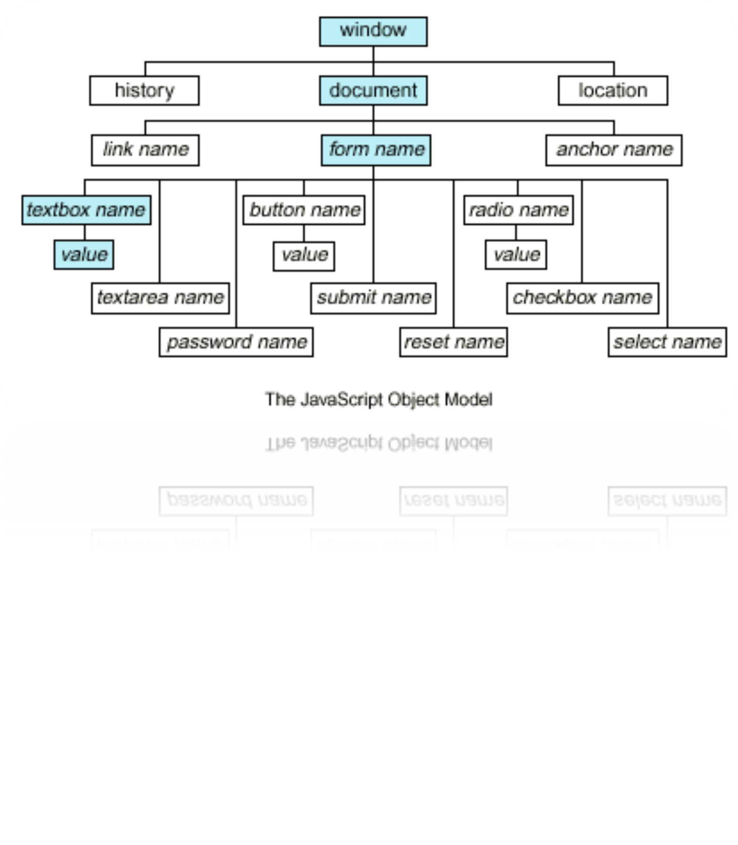

Slide 4
Document Object Model (DOM)
Every HTML element is accessible via the JavaScript DOM API
Most DOM objects can be manipulated by the programmer
The event model lets a document to react when the user does something on the page
Advantages
  Create interactive pages
  Updates the objects of a page without reloading it

Slide 5
Accessing Elements
Access elements via their ID attribute
Via the name attribute
Via tag name
  Returns array of descendant <img> elements of the element "el"
var elem = document.getElementById("some_id")
var arr = document.getElementsByName("some_name")
var imgTags = el.getElementsByTagName("img")

Slide 6
DOM Manipulation
Once we access an element, we can read and write its attributes
DOM-manipulation.html
function change(state) {
var lampImg = document.getElementById("lamp");
lampImg.src = "lamp_" + state + ".png";
var statusDiv =
document.getElementById("statusDiv");
statusDiv.innerHTML = "The lamp is " + state";
}
…
<img src="test_on.gif" onmouseover="change('off')"
onmouseout="change('on')" />

Slide 7
Common Element Properties
Most of the properties are derived from the HTML attributes of the tag
  E.g. id, name, href, alt, title, src, etc…
style property – allows modifying the CSS styles of the element
  Corresponds to the inline style of the element
    Not the properties derived from embedded or external CSS rules
  Example: style.width, style.marginTop, style.backgroundImage

Slide 8
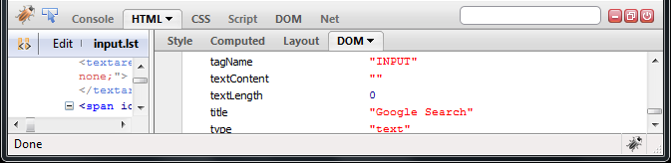
Common Element Properties (2)
className – the class attribute of the tag
innerHTML – holds all the entire HTML code inside the element
Read-only properties with information for the current element and its state
  tagName, offsetWidth, offsetHeight, scrollHeight, scrollTop, nodeType, etc…

Slide 9
Accessing Elements through the DOM Tree Structure
We can access elements in the DOM through some tree manipulation properties:
  element.childNodes
  element.parentNode
  element.nextSibling
  element.previousSibling
  element.firstChild
  element.lastChild

Slide 10
Accessing Elements through the DOM Tree – Example
var el = document.getElementById('div_tag');
alert (el.childNodes[0].value);
alert (el.childNodes[1].
getElementsByTagName('span').id);
…
<div id="div_tag">
<input type="text" value="test text" />
<div>
<span id="test">test span</span>
</div>
</div>
  accessing-elements-demo.html
  Warning: may not return what you expected due to Browser differences

Slide 11
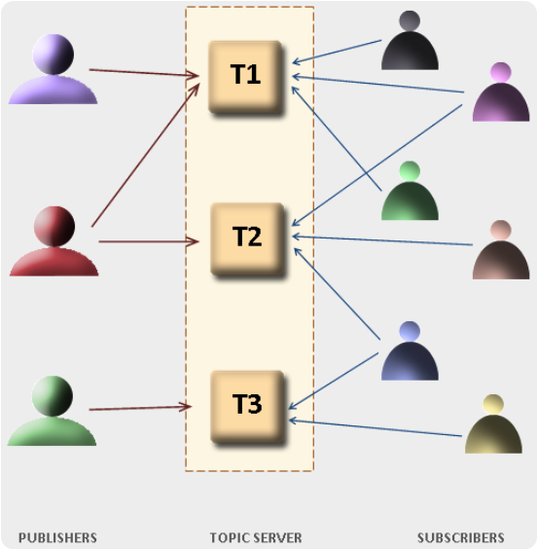
The HTML DOM Event Model

Slide 12
The HTML DOM Event Model
JavaScript can register event handlers
  Events are fired by the Browser and are sent to the specified JavaScript event handler function
  Can be set with HTML attributes:
  Can be accessed through the DOM:
<img src="test.gif" onclick="imageClicked()" />
var img = document.getElementById("myImage");
img.onclick = imageClicked;

Slide 13
The HTML DOM Event Model (2)
All event handlers receive one parameter
  It brings information about the event
  Contains the type of the event (mouse click, key press, etc.)
  Data about the location where the event has been fired (e.g. mouse coordinates)
  Holds a reference to the event sender
    E.g. the button that was clicked

Slide 14

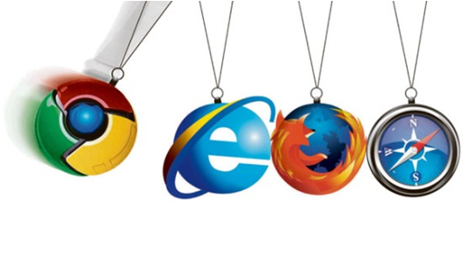
The HTML DOM Event Model (3)
  Holds information about the state of [Alt], [Ctrl] and [Shift] keys
  Some browsers do not send this object, but place it in the document.event
  Some of the names of the event’s object properties are browser-specific

Slide 15
Common DOM Events
Mouse events:
  onclick, onmousedown, onmouseup
  onmouseover, onmouseout, onmousemove
Key events:
  onkeypress, onkeydown, onkeyup
  Only for input fields
Interface events:
  onblur, onfocus
  onscroll

Slide 16
Common DOM Events (2)
Form events
  onchange – for input fields
  onsubmit
    Allows you to cancel a form submission
    Useful for form validation
Miscellaneous events
  onload, onunload
    Allowed only for the <body> element
    Fires when all content on the page was loaded / unloaded

Slide 17
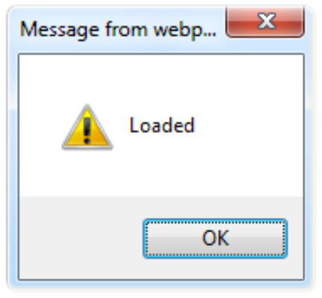
onload Event – Example
  onload.html
onload event
<html>
<head>
<script type="text/javascript">
function greet() {
alert("Loaded.");
}
</script>
</head>
<body onload="greet()" >
</body>
</html>

Slide 18


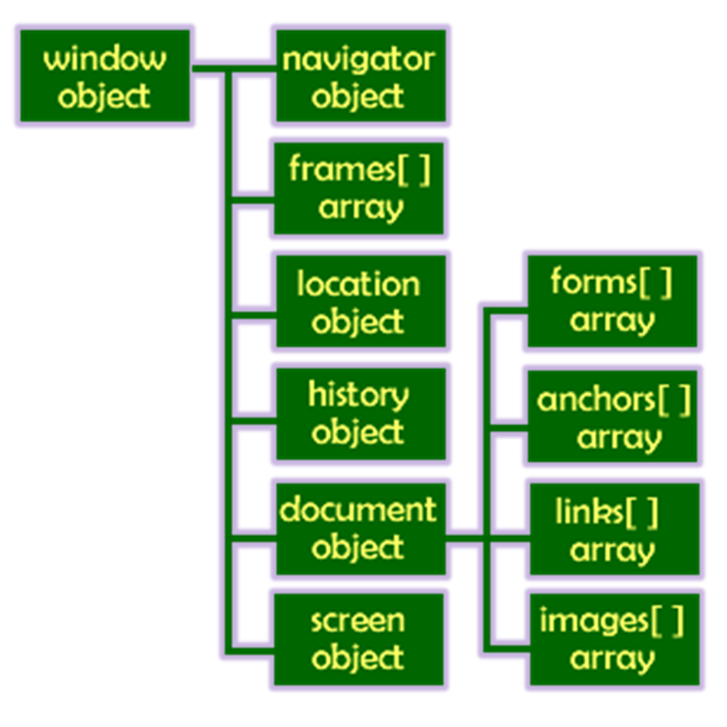
The Built-In Browser Objects

Slide 19
Built-in Browser Objects
The browser provides some read-only data via:
  window
    The top node of the DOM tree
    Represents the browser's window
  document
    holds information the current loaded document
  screen
    Holds the user’s display properties
  browser
    Holds information about the browser

Slide 20
DOM Hierarchy – Example
window
navigator
screen
document
history
location
form
form
button
form

Slide 21
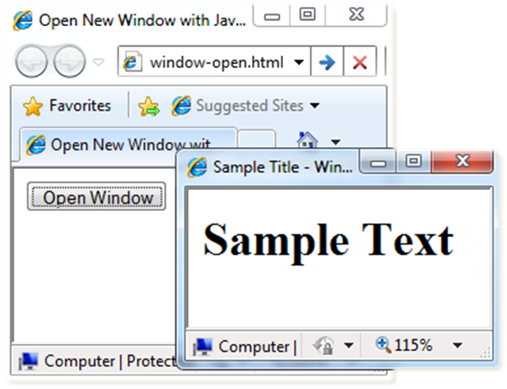
Opening New Window – Example
window.open()
  window-open.html
var newWindow = window.open("", "sampleWindow",
"width=300, height=100, menubar=yes,
status=yes, resizable=yes");
newWindow.document.write(
"<html><head><title>
Sample Title</title>
</head><body><h1>Sample
Text</h1></body>");
newWindow.status =
"Hello folks";

Slide 22
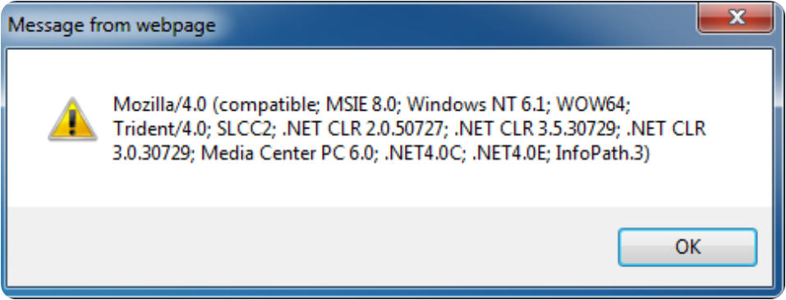
The Navigator Object
alert(window.navigator.userAgent);
The browser window
The navigator in the browser window
The userAgent (browser ID)

Slide 23

The Screen Object
The screen object contains information about the display
window.moveTo(0, 0);
x = screen.availWidth;
y = screen.availHeight;
window.resizeTo(x, y);

Slide 24
Document and Location
document object
  Provides some built-in arrays of specific objects on the currently loaded Web page
document.location
  Used to access the currently open URL or redirect the browser
document.links[0].href = "yahoo.com";
document.write(
"This is some <b>bold text</b>");
document.location = "http://www.yahoo.com/";

Slide 25
Form Validation – Example
  form-validation.html
function checkForm()
{
var valid = true;
if (document.mainForm.firstName.value == "") {
alert("Please type in your first name!");
document.getElementById("firstNameError").
style.display = "inline";
valid = false;
}
return valid;
}
…
<form name="mainForm" onsubmit="return checkForm()">
<input type="text" name="firstName" />
…
</form>

Slide 26
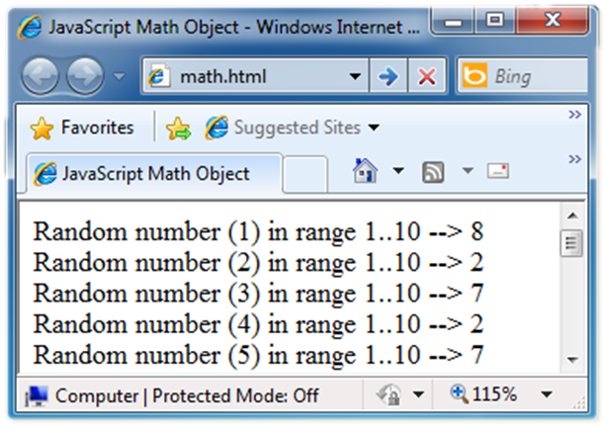
The Math Object
The Math object provides some mathematical functions
  math.html
for (i=1; i<=20; i++) {
var x = Math.random();
x = 10*x + 1;
x = Math.floor(x);
document.write(
"Random number (" +
i + ") in range " +
"1..10 --> " + x +
"<br/>");
}

Slide 27
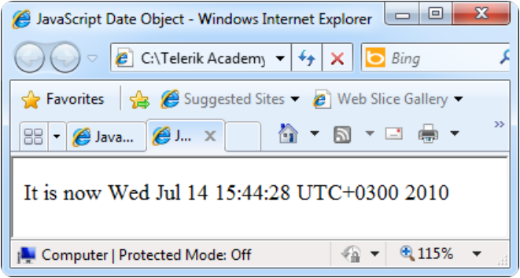
The Date Object
The Date object provides date / calendar functions
  dates.html
var now = new Date();
var result = "It is now " + now;
document.getElementById("timeField")
.innerText = result;
...
<p id="timeField"></p>

Slide 28
Timers: setTimeout()
Make something happen (once) after a fixed delay
var timer = setTimeout('bang()', 5000);
5 seconds after this statement executes, this function is called
clearTimeout(timer);
Cancels the timer

Slide 29
Timers: setInterval()
Make something happen repeatedly at fixed intervals
var timer = setInterval('clock()', 1000);
This function is called continuously per 1 second.
clearInterval(timer);
Stop the timer.

Slide 30
Timer – Example
  timer-demo.html
<script type="text/javascript">
function timerFunc() {
var now = new Date();
var hour = now.getHours();
var min = now.getMinutes();
var sec = now.getSeconds();
document.getElementById("clock").value =
"" + hour + ":" + min + ":" + sec;
}
setInterval('timerFunc()', 1000);
</script>
<input type="text" id="clock" />

Slide 31


Slide 32

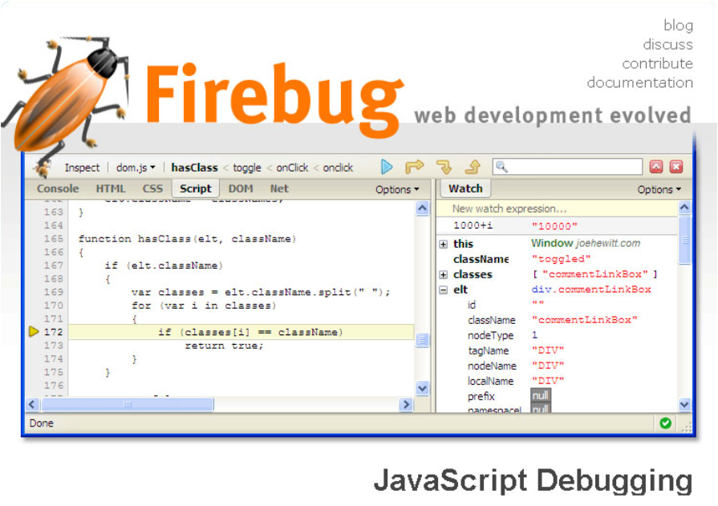
Debugging JavaScript

Slide 33
Debugging JavaScript
Modern browsers have JavaScript console where errors in scripts are reported
  Errors may differ across browsers
Several tools to debug JavaScript
  Microsoft Script Editor
    Add-on for Internet Explorer
    Supports breakpoints, watches
    JavaScript statement debugger; opens the script editor

Slide 34
Firebug
Firebug – Firefox add-on for debugging JavaScript, CSS, HTML
  Supports breakpoints, watches, JavaScript console editor
  Very useful for CSS and HTML too
    You can edit all the document real-time: CSS, HTML, etc
    Shows how CSS rules apply to element
  Shows Ajax requests and responses
  Firebug is written mostly in JavaScript

Slide 35
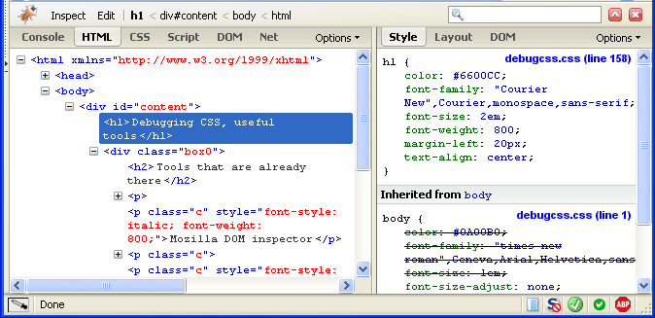
Firebug (2)

Slide 36
JavaScript Console Object
The console object exists only if there is a debugging tool that supports it
  Used to write log messages at runtime
Methods of the console object:
  debug(message)
  info(message)
  log(message)
  warn(message)
  error(message)

